Slide 1

Instacart Data Analysis
by Ben Pankin

Slide 2
What we’ll cover
Background of instacart
How it relates to us
The problem
Why we care
The Data
Cleaning
Exploring
Goal
Model Used
Insights
Next Steps

Slide 3
Background
Instacart is a grocery delivery service (think Lyft for the food you cook at home)
Similar to Postmates/Caviar users create a list of the food they want on an app
An Instacart delivery driver will purchase the groceries and deliver them
As of 2015, there are over 200 employees
As of March 2017, Instacart services 36 markets, composed of 1200 cities in 25 states in the US

Slide 4
How it relates to us
We’re all busy!
With work, General Assembly/other schooling, commuting, staying fit, other errands, social obligations etc. the world can be pretty overwhelming
The ability to automate one relatively time-consuming weekly task for a small fee is major key
Have you ever been to Trader Joe’s on a sunday night? (the horror!!)

Slide 5
Problem
Instacart released a portion of their data to the public (~3.2m records with additional tables)
The Real Problem: Kaggle competition to model Prior and Train data and Test on 75k test records to predict probability of people reordering specific items
My Problem: Run KMeans to cluster data for orders for item count = 10
Decide an appropriate amount of k’s
Perform additional EDA after order records are tagged with new cluster label

Slide 6
Why do we care?
We can find insights on who are the “produce buyers” vs. the “junk food buyer”
We can find the average day and time of day per cluster (regular grocery shopping vs. late night food)
Knowing what clusters people fall into and their buying habits could lead to a business benefit: Push notifications at certain times for certain foods

Slide 7
Data!
Instacart provided 3.4m records of data to the public
Data was broken into different files (aka relational tables)
Orders - data with user id, order number for user, day of week, and time of day: 3.4m records
Has train (130k records), prior (3.2m), and test (75k) data
Orders_Train - most recent order for users, product id, items placed in queue per order, reorder flag: 1.3m
Orders_Prior - previous orders for users, product id, items placed in queue per order, reorder flag: 3.2m records
NOTE: no Order_Test. That being missing is the basis of the kaggle competition
Aisles - aisle id, aisle name: 134 records
Departments - department id, department name: 21 records
Products - product id, product name, aisle id, department id: ~50k records

Slide 8
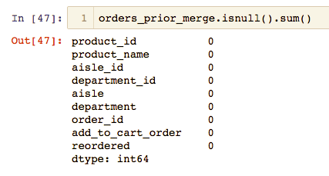

Data - Cleaning
Merged data together
Product had all id’s, so merged orders to products and then aisles and departments to newly merged dataframe
Instacart was nice and kept their data clean so no null values or duplicates

Slide 9
Data - Exploring
Looked at dtypes, shape, .head() to get a sense of the columns in the data
Dropped superfluous columns (after merge, didn't need id’s anymore
Top orders by aisle, department
Top order total (banana, bag of organic bananas was 2nd)
Top aisle/department by order count

Slide 10
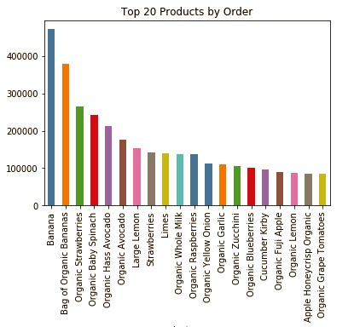
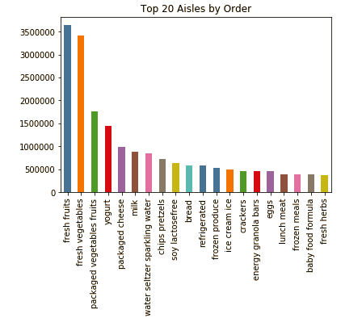
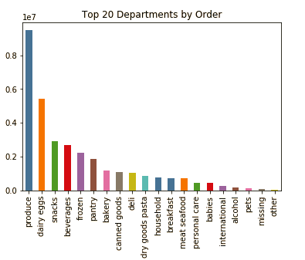
Some Graphs!

Slide 11
Goal
Be able to cluster a sample of the data where the number of items in an order is 10
Choose an accurate amount of k’s
Identify the inertia (density of cluster -- low = denser cluster) and Silhouette Score (distance clusters are from one another -- high = clusters are well separated)
Perform EDA on data with new cluster label

Slide 12
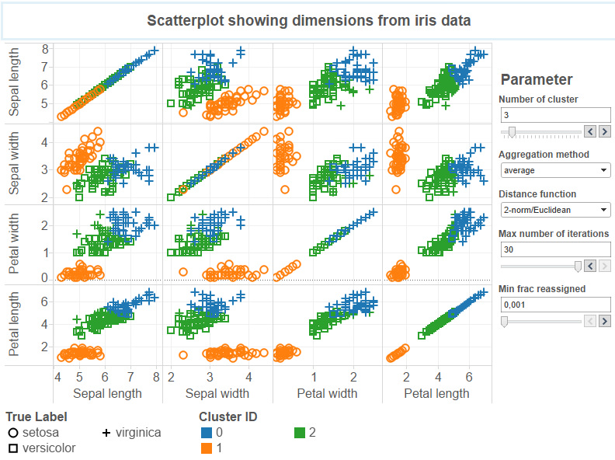
Model Used
KMeans clustering
Metrics for model fit varying data and k’s:
Inertia
Silhouette Score

Slide 13
Process
Merged prior and train together to have a union of all orders
Added column ‘order_count’ and filtered when ‘order_count’ = 10
Dropped unneeded columns
Merged with products to get product name
Took a sample of 10k records of the data (my CPU thanked me)
Created dummy variables for the 4,530 unique products
Dataframe was 10000 x 4536 (my CPU did not thank me 😔)
Ran KMeans on the dataframe and evaluated the inertia and silhouette score
Tested on multiple k’s (landed at k=100…..labels af)

Slide 14
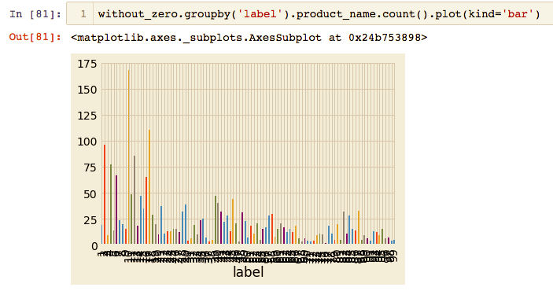
Insights
As k increased, inertia and silhouette score decreased and increased respectively
Besides centroid 0, distribution is relatively equal

Slide 15
Next Steps
Go more in depth on the EDA after clustering
Sample other data not just the 50k records (maybe do a k-folds to get a better distribution of data)
Align my code with data science best practices
Using accurate variables
Commenting cells more and adding docstring
Making graphs more viewable for user
Cluster on other k’s and provide further analysis
Make more graphs (need more time since the dummy variables make it a very large dataframe)
Add more puns to my jupyter notebooks

Slide 16
Questions

